Slide 1
DEVELOPMENT OF SURFACES
DEVELOPMENT OF SURFACES:-
The complete surface of an object when laid out on a plane is called the development of the surface.
METHODS OF DEVELOPMENT:-
Parallel Line Method:
It is used for the development of prisms and cylinders in which the lines drawn to represent the different elements of the surfaces are parallel to each other.
Radial Line Method:
It is used for the development of pyramids and cones in which the apex is taken as centre and its slant edge or generator as the radius for its development.

Slide 2
DEVELOPMENT OF SURFACES
PRISM
It consists of top & bottom face. These faces are parallel to each other & are of same shape & size. There are no. of side faces which can be rectangular or parallelogram equal to the no. of sides of polygon used at top or bottom face.
PYRAMID
It consists of a polygon at base and apex at the top. There are no. of triangular faces equal to the no. of sides of the polygon. These triangular faces meet at a common point at top called apex.

Slide 3
PROBLEMS RELATED TO CYLINDER

Slide 4
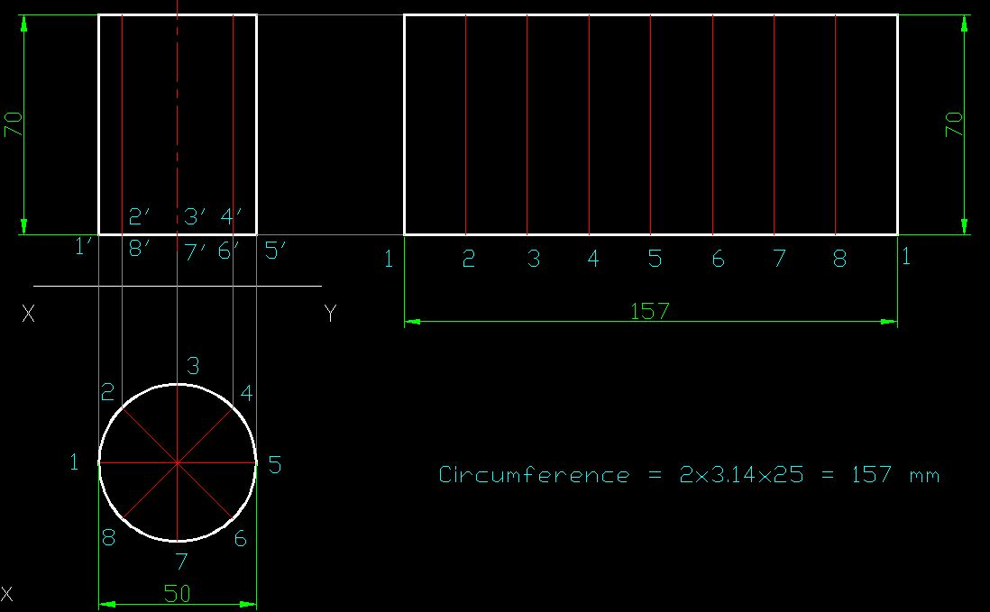
Q 1. A cylinder of base dia 50 mm and height of axis 70 mm is resting on its base. Develop the lateral surface of the cylinder.

Slide 5
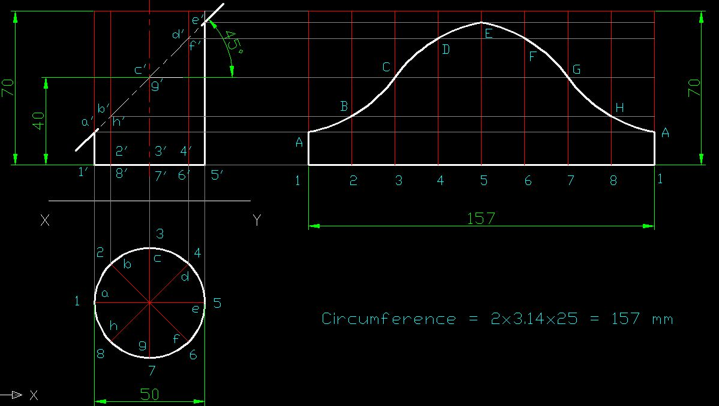
Q 2. A cylinder of base dia 50 mm and height of axis 70 mm is resting on its base. It is cut by a cutting plane which is inclined at 45 deg to HP and passes through a point 40 mm from base along the axis of the cylinder. Develop the lateral surface of the truncated cylinder.

Slide 6
PROBLEMS RELATED TO PRISM

Slide 7
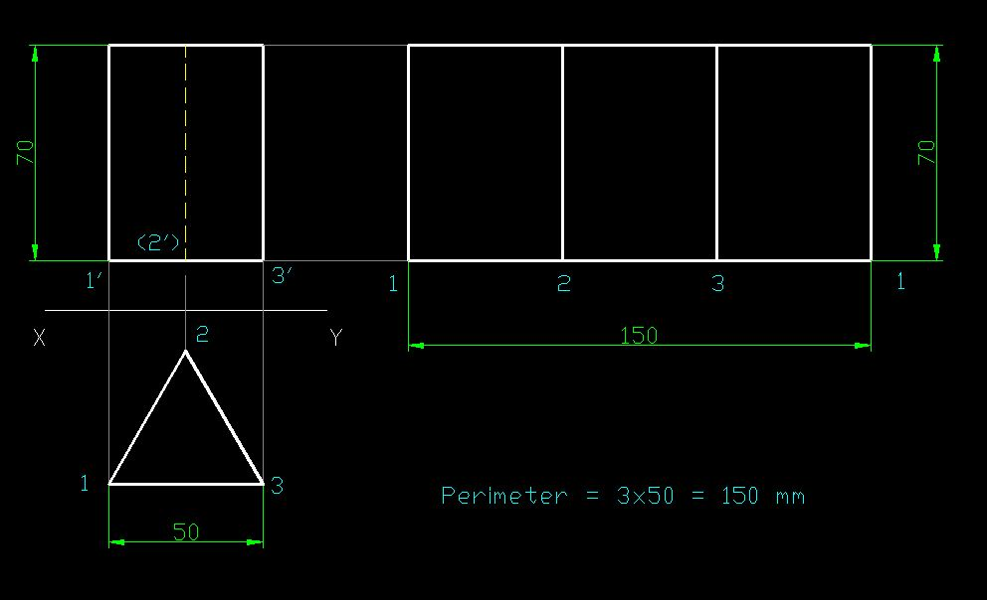
Q 1. A triangular prism of base 50 mm and height 70 mm is resting on its base such that one of its base edge is parallel to VP. Develop the lateral surface.

Slide 8
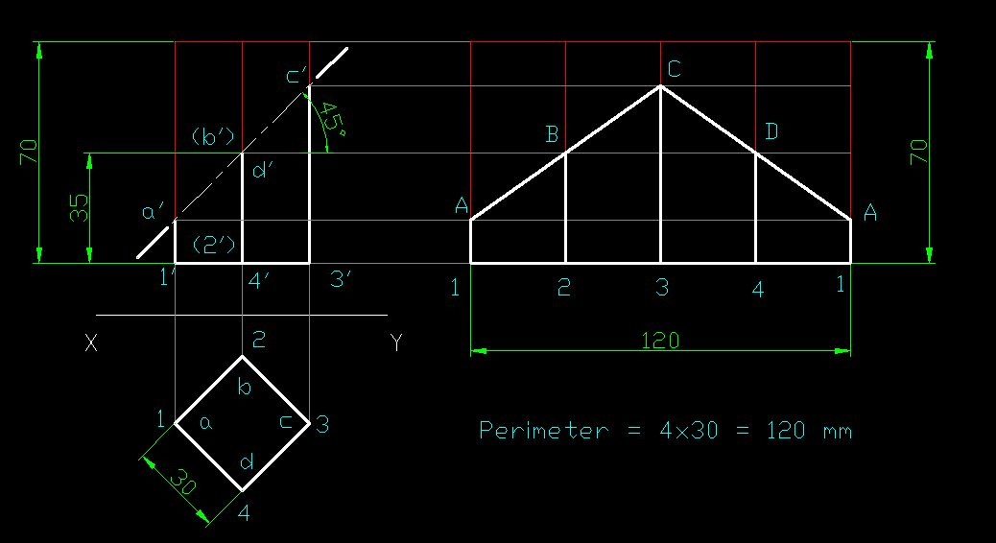
Q 2. A square prism of base 30 mm and height 70mm is resting on its base such that one of its base edge makes angle 45 degree with the VP. It is cut by a cutting plane inclined at 45 degree to HP and it bisects the axis of the prism. Develop lateral surface of the truncated prism.

Slide 9
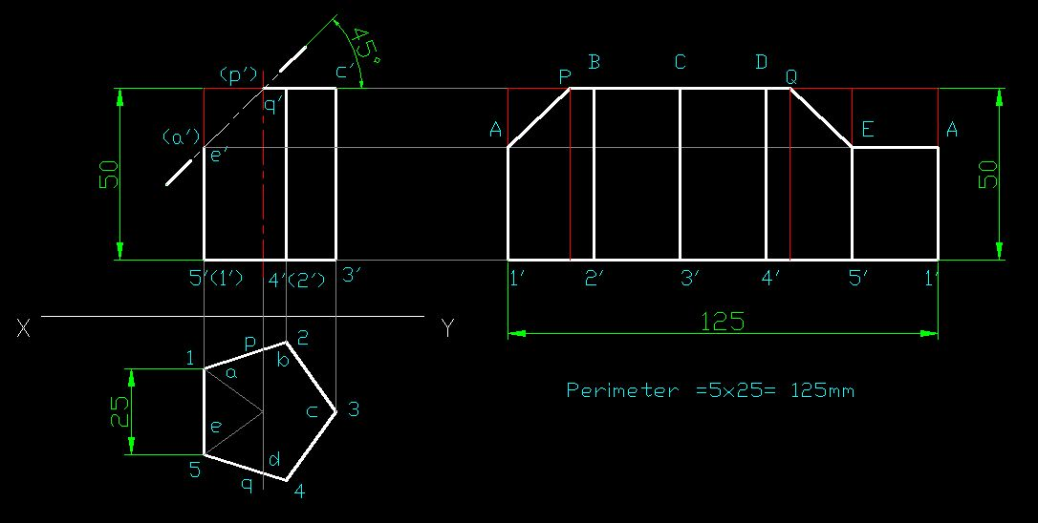
Q 3. A pentagonal prism of base 25 mm and height 50 mm is resting on its base such that one of its base edge is perpendicular to VP. It is cut by a cutting plane inclined at 45 degree to HP and passes through the center of top face. Develop the lateral surface.

Slide 10
PROBLEMS RELATED TO CONE

Slide 11
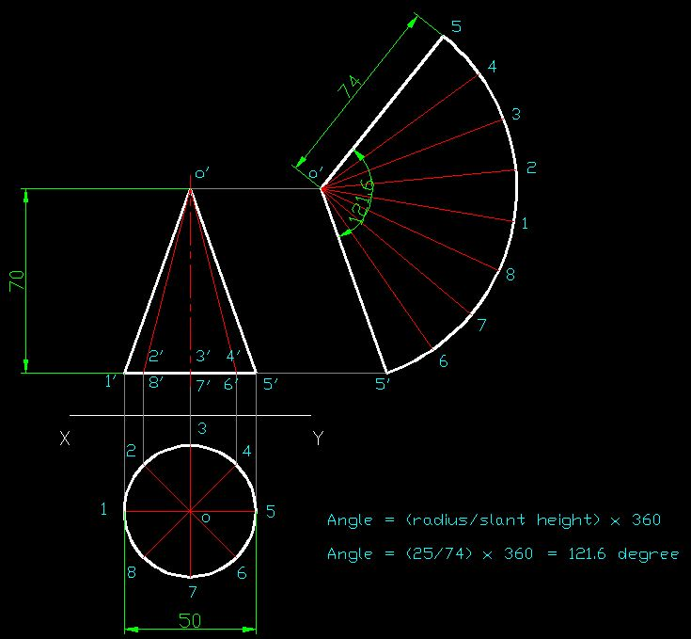
Q. A cone of base dia 50 mm and height 70mm is resting on its base. Develop the lateral surface of the cone.

Slide 12
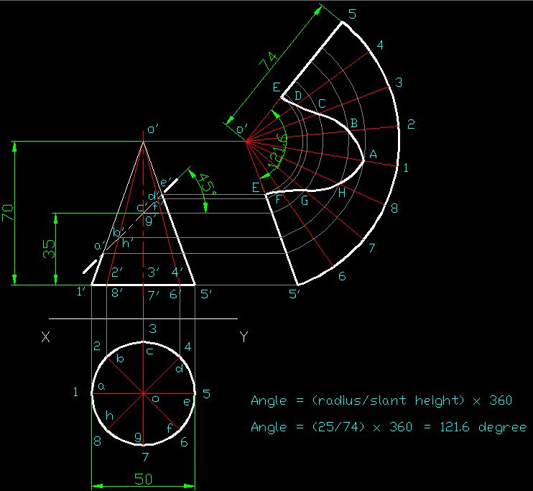
Q. A cone of base dia 50 mm and height 70mm is resting on its base. It is cut by a cutting plane inclined at 45 degree to HP and bisects the axis of the cone. Develop the lateral surface of the truncated cone.

Slide 13
PROBLEMS RELATED TO PYRAMID

Slide 14
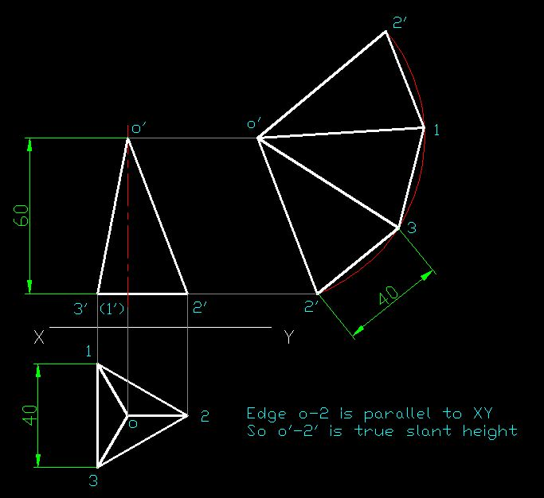
Q. A triangular pyramid of base 40 mm and height 60 mm is resting on its base such that one of its base edge is perpendicular to VP. Develop its lateral surface.

Slide 15
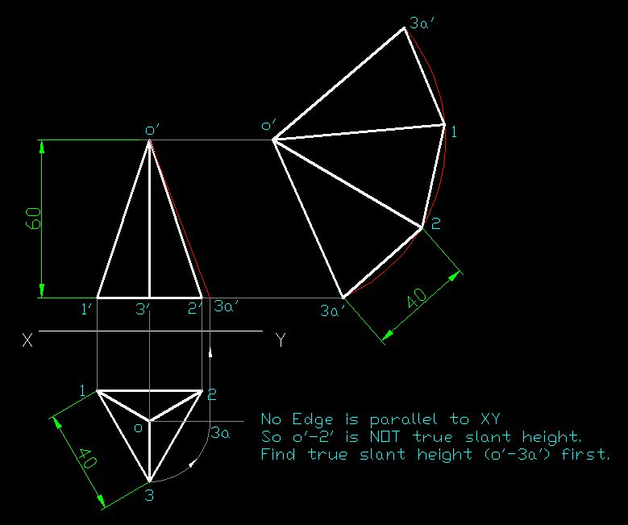
Q. A triangular pyramid of base 40 mm and height 60 mm is resting on its base such that one of its base edge is parallel to VP. Develop its lateral surface.

Slide 16
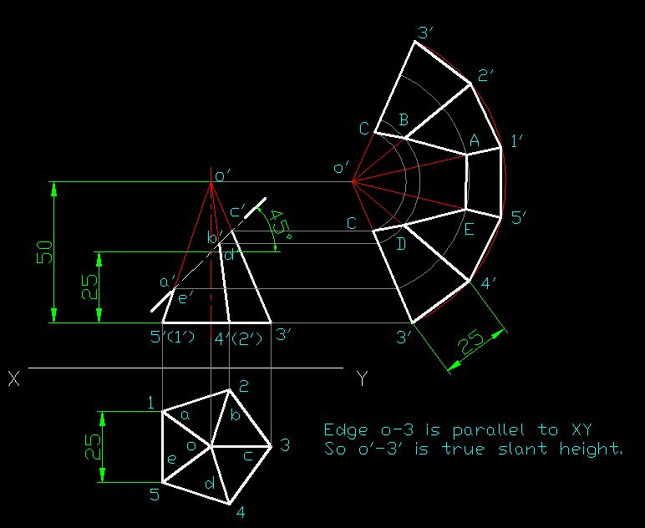
Q. A pentagonal pyramid of base 25 mm and height 50 mm is resting on its base such that one of its base edge is perpendicular to VP. It is cut by a cutting plane inclined at 45 degree to HP and passes through a point 25 mm from base along axis. Develop the lateral surface of truncated pyramid.

